Slide 1
ASP.NET MVC
ASP.NET Core MVC Framework

Slide 2
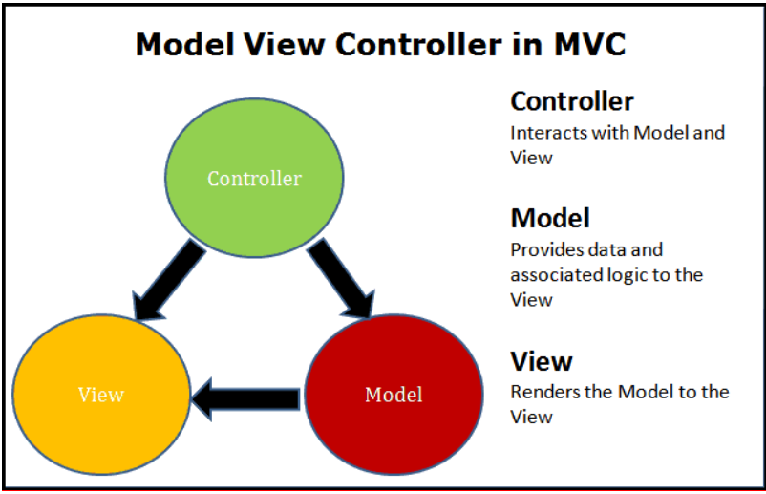

Slide 3
1. Introduction to ASP.NET MVC
ASP.NET MVC is a framework for building web applications using the Model-View-Controller (MVC) pattern.
It helps separate concerns for better maintainability and scalability.

Slide 4
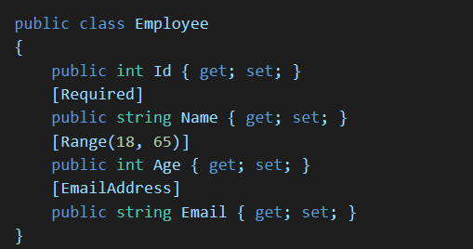
2. Models
Creating Models
Models represent data and business logic in an MVC application.
Example: Creating an Employee model

Slide 5

3. Views
Razor allows embedding C# code into HTML using @ symbol.

Slide 6
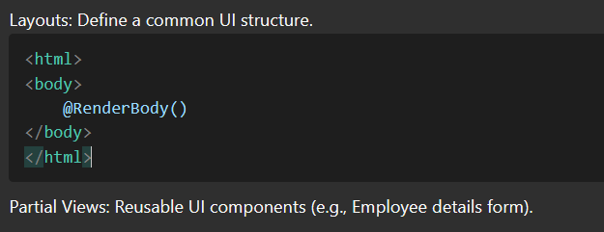
Layouts and Partial Views

Slide 7
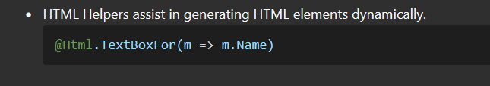
HTML Helpers

Slide 8
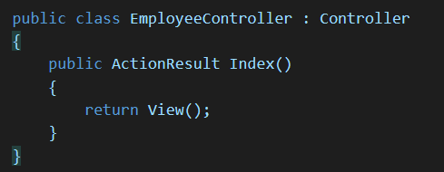
4. Controllers
Creating Controllers
Controllers handle HTTP requests and return responses.

Slide 9
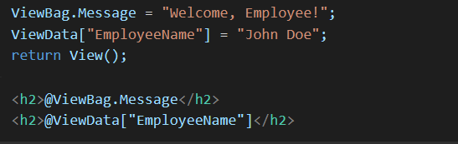
ViewBag, ViewData, and TempData
ViewBag and ViewData are used to pass data to views.
ViewBag is a dynamic property, and values can be assigned directly.
ViewData is a dictionary of key-value pairs.
Both are valid only for the current request.

Slide 10
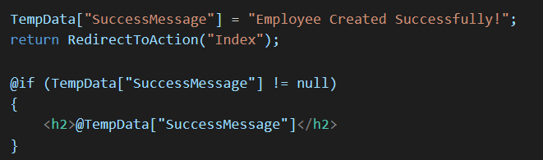
TempData retains data between requests and is useful for redirects.

